Slide 1
THE CHINOOK MUSIC STORE DATABASE

Slide 2
Agenda
INTRODUCTION
DATABASE SCHEMA
INSIGHTS
CONCLUSION

Slide 3
PROBLEM STATEMENT
1. Identify and address missing values and duplicates to ensure data integrity.
2. Determine top-selling tracks, artists, and genres, both in the USA and globally.
3. Segment customers based on purchase history to predict lifetime value and identify high-risk groups.
4. Analyze customer demographics and purchasing behavior, including churn rate and frequency.
5. Calculate total revenue and top customers by region, with a focus on geographical differences.
6. Recommend albums for promotion based on genre sales performance and customer preferences.

Slide 4
INTRODUCTION
1. THE MAIN OBJECTIVE OF THIS PROJECT IS TO EXPLORE AND ANALYSE THE CHINOOK DATABASE USING SQL TO UNCOVER VALUABLE BUSINESS INSIGHTS.
2. THIS INVOLVES QUERYING THE DATABASE TO GAIN A DEEPER UNDERSTANDING OF CUSTOMER BEHAVIOUR, SALES, TRENDS, AND THE MANAGEMENT OF THE MUSIC LIBRARY.
3. IN THE MODERN BUSINESS ENVIRONMENT, DATA ANALYSIS PLAYS A VITAL ROLE IN DECISION-MAKING.
4. BY LEVERAGING SQL, BUSINESSES CAN EXTRACT MEANINGFUL PATTERNS AND TRENDS FROM THEIR DATA, ENABLING THEM TO MAKE INFORMED DECISIONS, OPTIMIZE STRATEGIES, AND IMPROVE OVERALL PERFORMANCE.

Slide 5
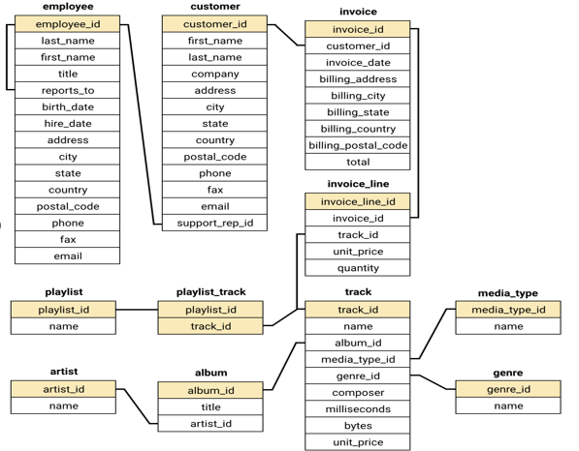
DATABASE SCHEMA

Slide 6
INSIGHTS
# TOTAL REVENUE AND NUMBER OF INVOICES FOR EACH COUNTRY, STATE, AND CITY?
# TOP 5 CUSTOMERS BY TOTAL REVENUE IN EACH COUNTRY
# CUSTOMERS WHO HAVE PURCHASED TRACKS FROM AT LEAST 3 DIFFERENT GENRES
# AVERAGE ORDER VALUE FOR EACH CUSTOMER
# TOTAL REVENUE GENERATED BY EACH CUSTOMER
# THREE ALBUMS -- PRIORITIZED FOR ADVERTISING AND PROMOTION IN THE USA BASED ON GENRE SALES ANALYSIS
# GENRES, ARTISTS, OR ALBUMS FREQUENTLY PURCHASED TOGETHER BY CUSTOMERS
# CUSTOMER PURCHASING BEHAVIORS BY REGION
NUMBER OF CUSTOMERS AND THE AVERAGE NUMBER OF TRACKS PURCHASED PER CUSTOMER

Slide 7
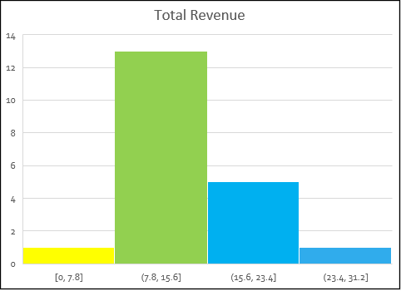
TOTAL REVENUE AND NUMBER OF INVOICES FOR EACH COUNTRY, STATE, AND CITY?
The customer base is geographically diverse, with customers spread across multiple countries, including Argentina, Australia, Brazil, Canada, and the USA.
In the USA, Mountain View, California, and London in the United Kingdom have the highest number of customers, with two customers each.
The data indicates that many cities have only one customer, suggesting a wide but shallow customer distribution.
Major cities like Paris, Berlin, São Paulo, and Prague also have a slightly higher concentration of customers compared to other locations.
There is a notable presence of customers in Canada, with representation in multiple provinces such as Ontario, British Columbia, Alberta, and Quebec.

Slide 8
TOP 5 CUSTOMERS BY TOTAL REVENUE IN EACH COUNTRY
The highest revenue-generating customer is František Wichterlová from the Czech Republic, with a total revenue of 144.54.
Customers are spread across various countries, with notable contributions from Brazil, the USA, Canada, and the Czech Republic.
Brazil has a significant number of top customers, with multiple entries in the top revenue rankings.
Many countries have customers with similar revenue figures, indicating a broad and relatively even distribution of high-value customers.
The USA has several high-revenue customers, with Jack Smith leading the list at 98.01 in revenue.

Slide 9
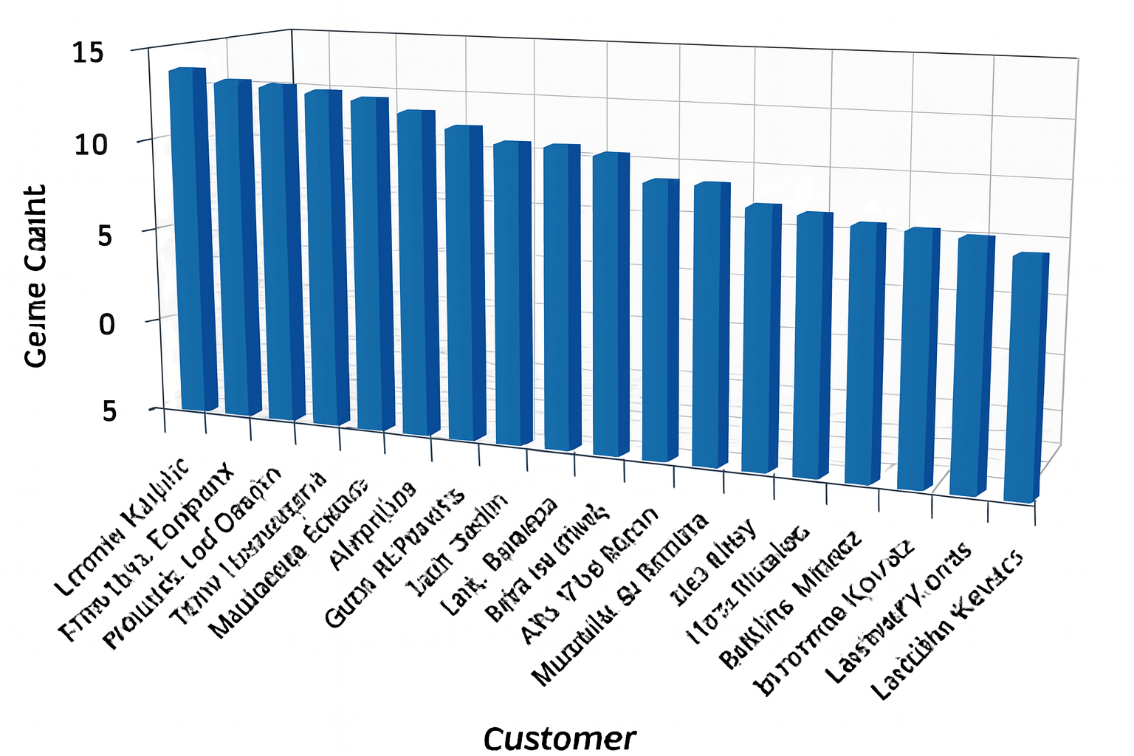
CUSTOMERS WHO HAVE PURCHASED TRACKS FROM AT LEAST 3 DIFFERENT GENRES
Leonie Köhler is the customer with the highest genre diversity, having purchased tracks across 14 different genres.
Several customers, including František Wichterlová, Terhi Hämäläinen, Madalena Sampaio, and others, have purchased from 13 different genres, indicating a broad music taste.
Many customers fall within the 10 to 12 genre count range, showing a wide but moderate variety in their music preferences.
A few customers, like Robert Brown, Kara Nielsen, and Victor Stevens, have engaged with only 5 to 6 genres, suggesting a more focused or niche musical interest.
Overall, the data indicates that most customers are exploring a diverse range of genres, with many engaging with more than 10 different genres.

Slide 10
AVERAGE ORDER VALUE FOR EACH CUSTOMER
François Tremblay has the highest average order value at 11.11, indicating that this customer spends more per order compared to others.
Customers like Helena Holý and Robert Brown also have high average order values above 10, showing they are likely to be high-value customers.
A significant number of customers have average order values ranging between 7 and 9, suggesting a moderate spending pattern across the customer base.
Customers like Kara Nielsen and Mark Philips have significantly lower average order values, with Mark Philips having the lowest at 2.97, indicating more frequent but smaller purchases.
The data shows a wide range of average order values, reflecting diverse spending behaviors among the customers.

Slide 11
TOTAL REVENUE GENERATED BY EACH CUSTOMER
FRANTIŠEK WICHTERLOVÁ IS THE HIGHEST REVENUE-GENERATING CUSTOMER, CONTRIBUTING 144.54 IN TOTAL REVENUE.
CUSTOMERS LIKE HELENA HOLÝ, HUGH O'REILLY, AND MANOJ PAREEK ALSO HAVE HIGH TOTAL REVENUES, EACH EXCEEDING 100, INDICATING THEY ARE KEY CONTRIBUTORS TO THE BUSINESS.
THE REVENUE DISTRIBUTION SPANS A WIDE RANGE, WITH THE TOP CUSTOMERS GENERATING SIGNIFICANTLY MORE REVENUE THAN THOSE AT THE LOWER END OF THE SPECTRUM, SUCH AS MARK PHILIPS, WHO HAS THE LOWEST TOTAL REVENUE AT 29.7.
A LARGE NUMBER OF CUSTOMERS CONTRIBUTE BETWEEN 70 AND 100 IN TOTAL REVENUE, SHOWING A STRONG MIDDLE-TIER CUSTOMER BASE.
FEW CUSTOMERS, SUCH AS KARA NIELSEN AND ROBERT BROWN, CONTRIBUTE RELATIVELY LOWER REVENUE, SUGGESTING THEY MAY BE INFREQUENT PURCHASERS OR FOCUS ON LOWER-PRICED ITEMS.

Slide 12
THREE ALBUMS -- PRIORITIZED FOR ADVERTISING AND PROMOTION IN THE USA BASED ON GENRE SALES ANALYSIS
GENERE – NAME | ALBUM-ID | NEW RECORD LABEL | TOTAL GENRE SALES
ROCK | 163 | From The Muddy Banks Of The Wishkah [live] | 27.72
ROCK | 120 | Are You Experienced? | 27.72
ROCK | 214 | The Doors | 26.73
Genre Popularity: Rock is the dominant genre with the highest total sales figures. The top three albums all belong to this genre, indicating a strong market preference for Rock music in the USA.
Sales Figures: The selected albums have the highest total genre sales, making them strong candidates for promotion.
Given the strong sales performance of these albums in the Rock genre, they should be prioritized for advertising and promotion in the USA to capitalize on their popularity.

Slide 13
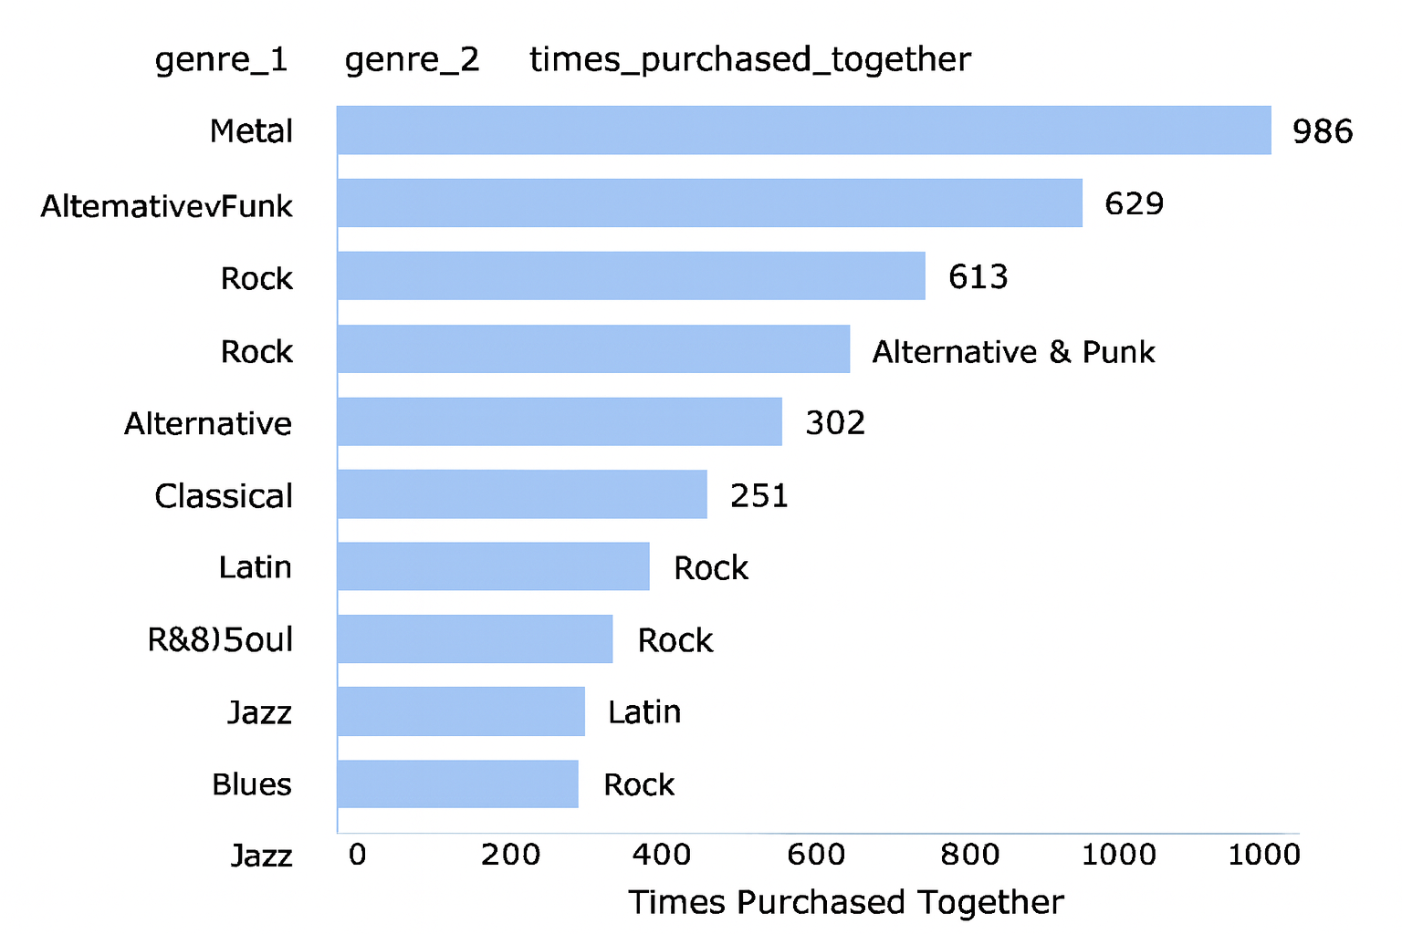
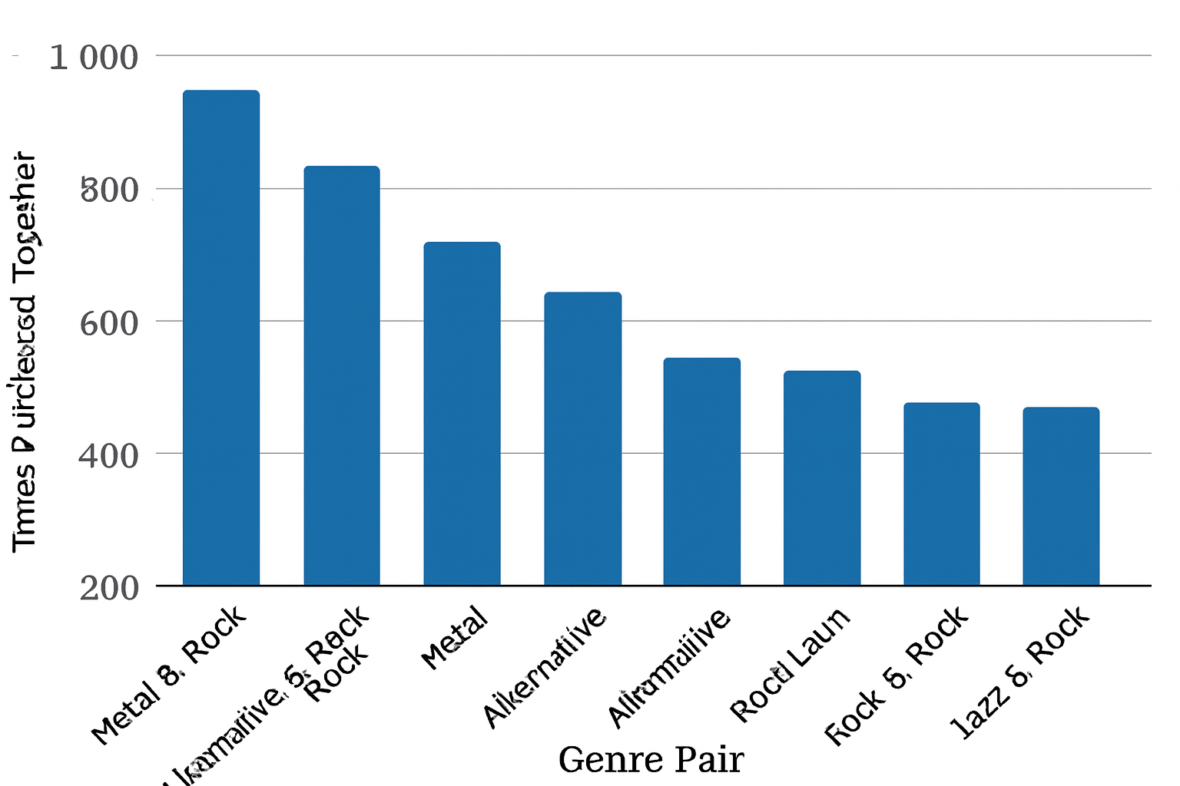
GENRES, ARTISTS, OR ALBUMS FREQUENTLY PURCHASED TOGETHER BY CUSTOMER
Metal and Rock, along with Alternative & Punk and Rock, are often purchased together, indicating shared fan bases.
Latin and R&B/Soul also pair with Rock, suggesting potential for cross-genre promotions.
Green Day and Led Zeppelin, as well as Nirvana and The Rolling Stones, are often bought together, showing cross-genre appeal.
Co-purchases of artists like System Of A Down with Foo Fighters and Queen with The Police highlight popular listener combinations.

Slide 14
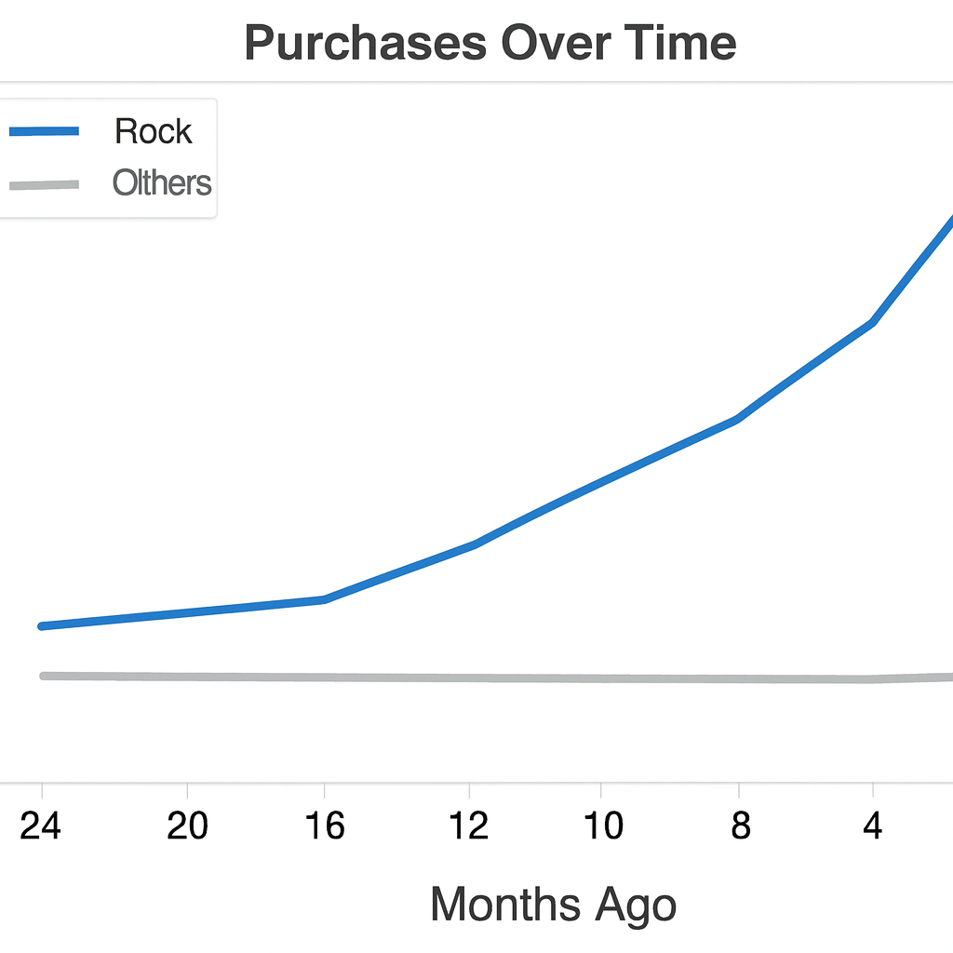
CONTINUING LAST INSIGHT…
"Mezmerize" is often paired with classic rock albums like "Are You Experienced?" and "The Police Greatest Hits," showing broad appeal.
Frequent co-purchases of "The Police Greatest Hits" with "My Generation" and "Big Ones" with "Back to Black" indicate strong cross-genre interests.

Slide 15
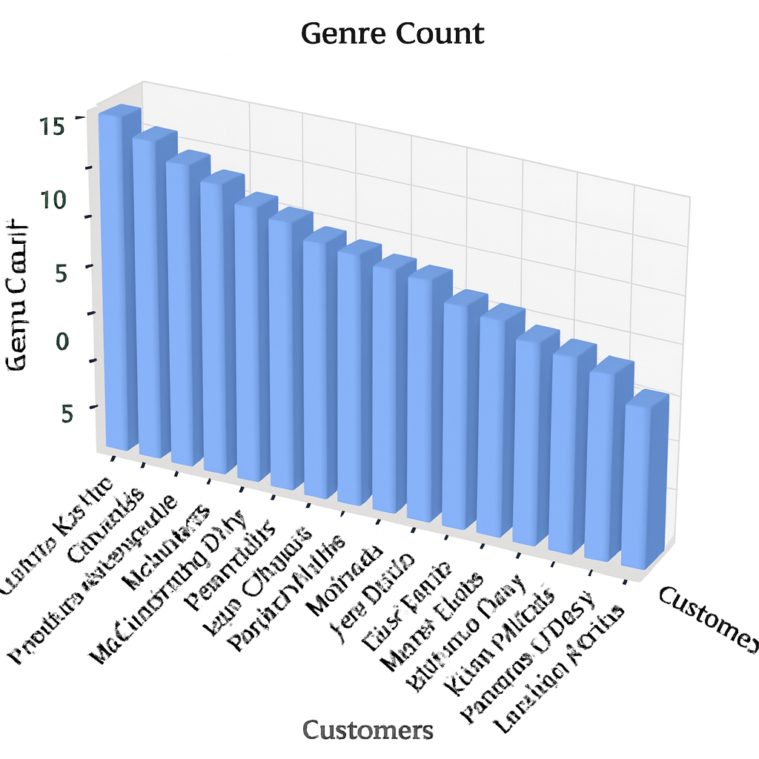
CUSTOMER PURCHASING BEHAVIORS BY REGION
High order value and frequency in Prague, Mountain View, and London: Ideal for premium products.
Moderate in São Paulo and Berlin: Focus on retention and repeat purchases.
Low in Edmonton and Copenhagen: Use promotions to boost sales.

Slide 16
CONCLUSION
Data Integrity: Null values and duplicates were addressed to ensure data accuracy across the Chinook database.
Top Performers: Rock is the most popular genre, particularly in the USA. Focusing on Rock music can enhance market engagement.
Customer Behavior: Long-term customers show higher spending, indicating strong loyalty. New customers have growth potential through personalized promotions.
Market Analysis: Rock music dominates globally, except in regions like Brazil, which favor Alternative & Punk and Metal.
Product Affinity: Identified popular genres and artists can guide cross-selling and bundling strategies.
Risk Management: High-value customers need tailored engagement to prevent churn. Predictive models can identify at-risk customers.
Recommendations: Focus on high-performing genres, implement loyalty programs, and use data-driven insights for targeted marketing.

Slide 17
THANK YOU

